Slide 1
Data science
and
Alan Schoen

Slide 2
What is 23andme?
Direct-to-consumer genetic testing service
Generates ML-based findings about ancestry
Links results to published science about genetic traits and medical risk
Conducts studies by sending questionnaires to users
Sells data for research

Slide 4
SNP arrays
Notes:
Usually 2 variants, sometimes 3

Slide 5
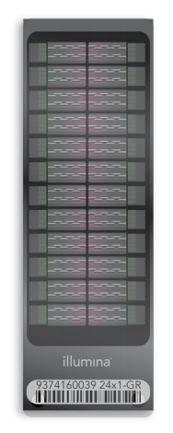
Genetic test
Illumina HumanOmniExpress-24 format chip
High-throughput test using pre-selected SNPs
Tests 713,599 SNPs across the genome
Fewer than 1% of the nucleotides in human genome, selected for relevance to scientific findings
3 minutes to do measurements, but computing results takes a lot of time and computing power
Notes:
BeadChip http://www.illumina.com/content/dam/illumina-marketing/documents/products/datasheets/datasheet_human_omni_express.pdf

Slide 6
Ancestry

Slide 7
ML application: ancestry
Start with database of individuals with known ancestry (public + own data)
Divide genome into windows of about 100 markers
Classify each window
Smooth across adjacent windows to handle borderline windows
Notes:
https://www.23andme.com/ancestry_composition_guide/

Slide 8
Ancestry of an African American user

Slide 9
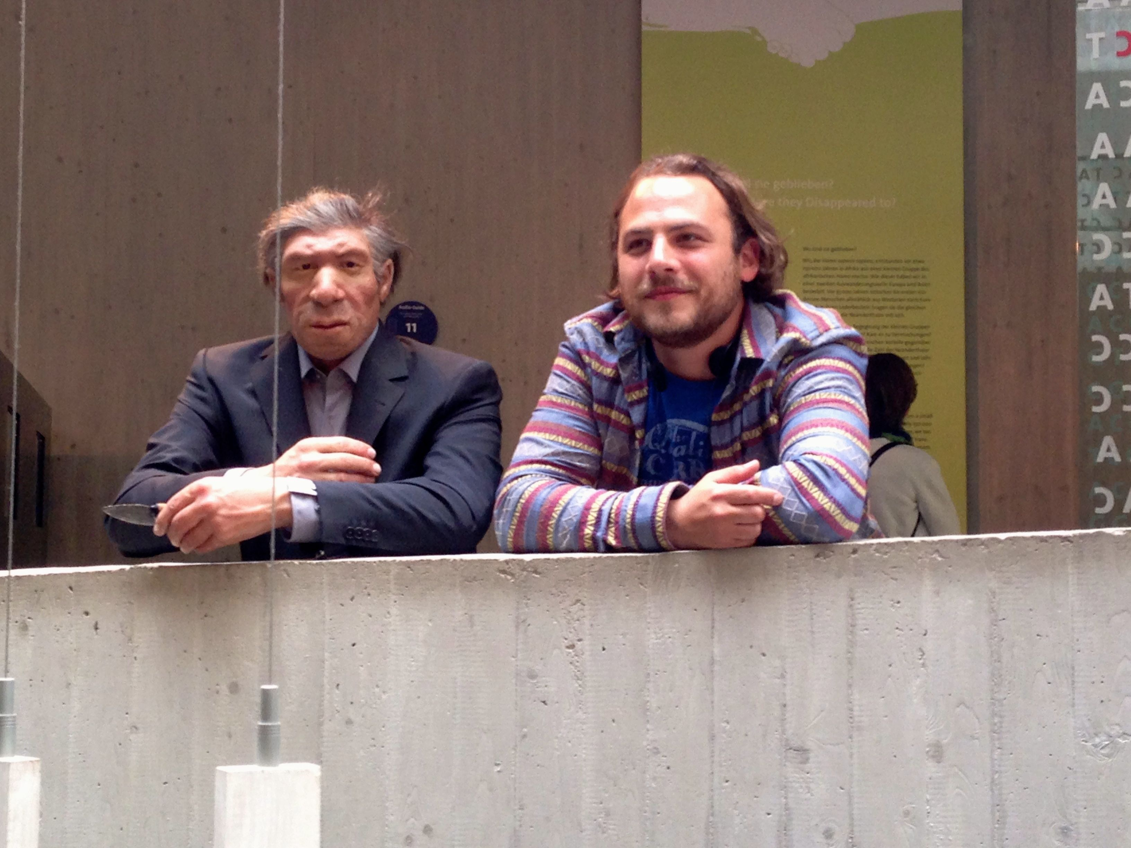
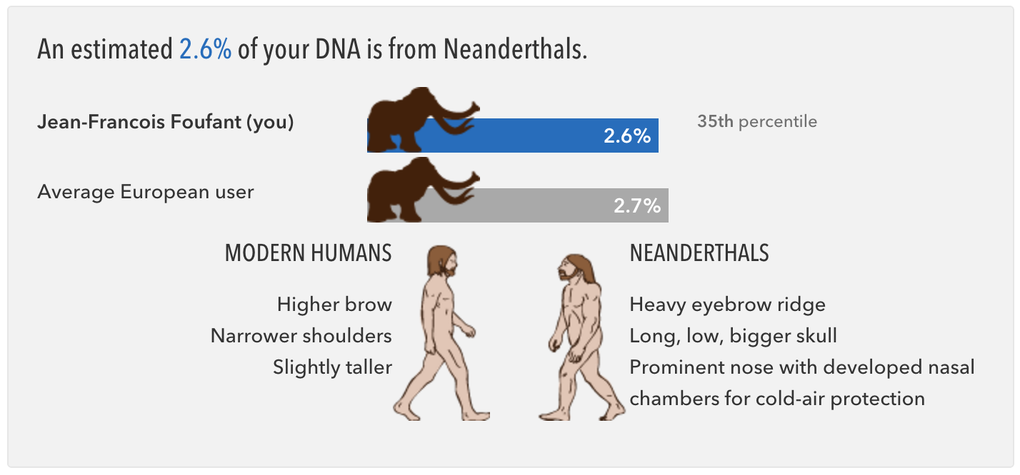
Notes:
https://23andme.https.internapcdn.net/res/pdf/hXitekfSJe1lcIy7-Q72XA_23-05_Neanderthal_Ancestry.pdf

Slide 10
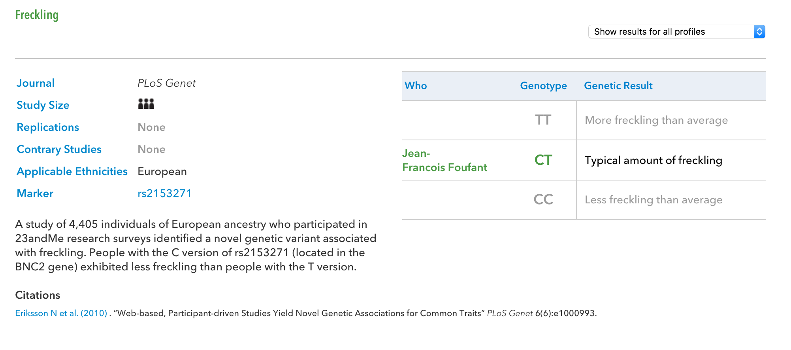

Slide 11
Medical results

Slide 12
FDA problems with medical results
FDA sent a warning letter in 2013
23andme suspended medical results in USA
Resumed in 2015 with FDA approval
Notes:
http://www.fda.gov/ICECI/EnforcementActions/WarningLetters/2013/ucm376296.htm
http://blog.23andme.com/news/a-note-to-our-customers-regarding-the-fda/

Slide 13
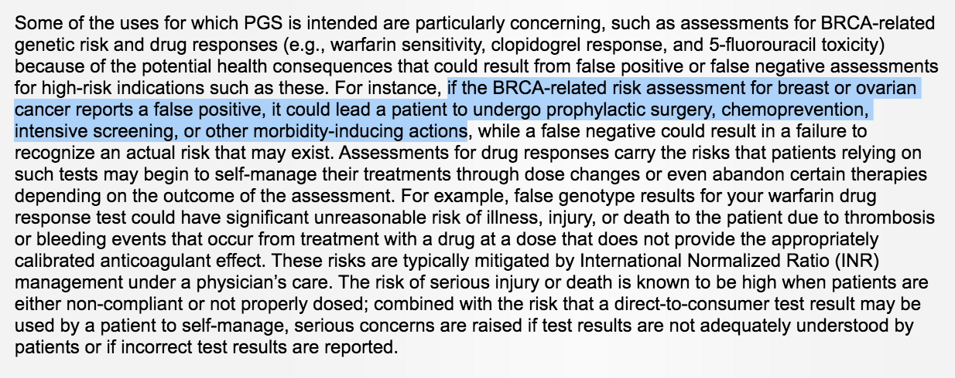
FDA warning letter

Slide 14
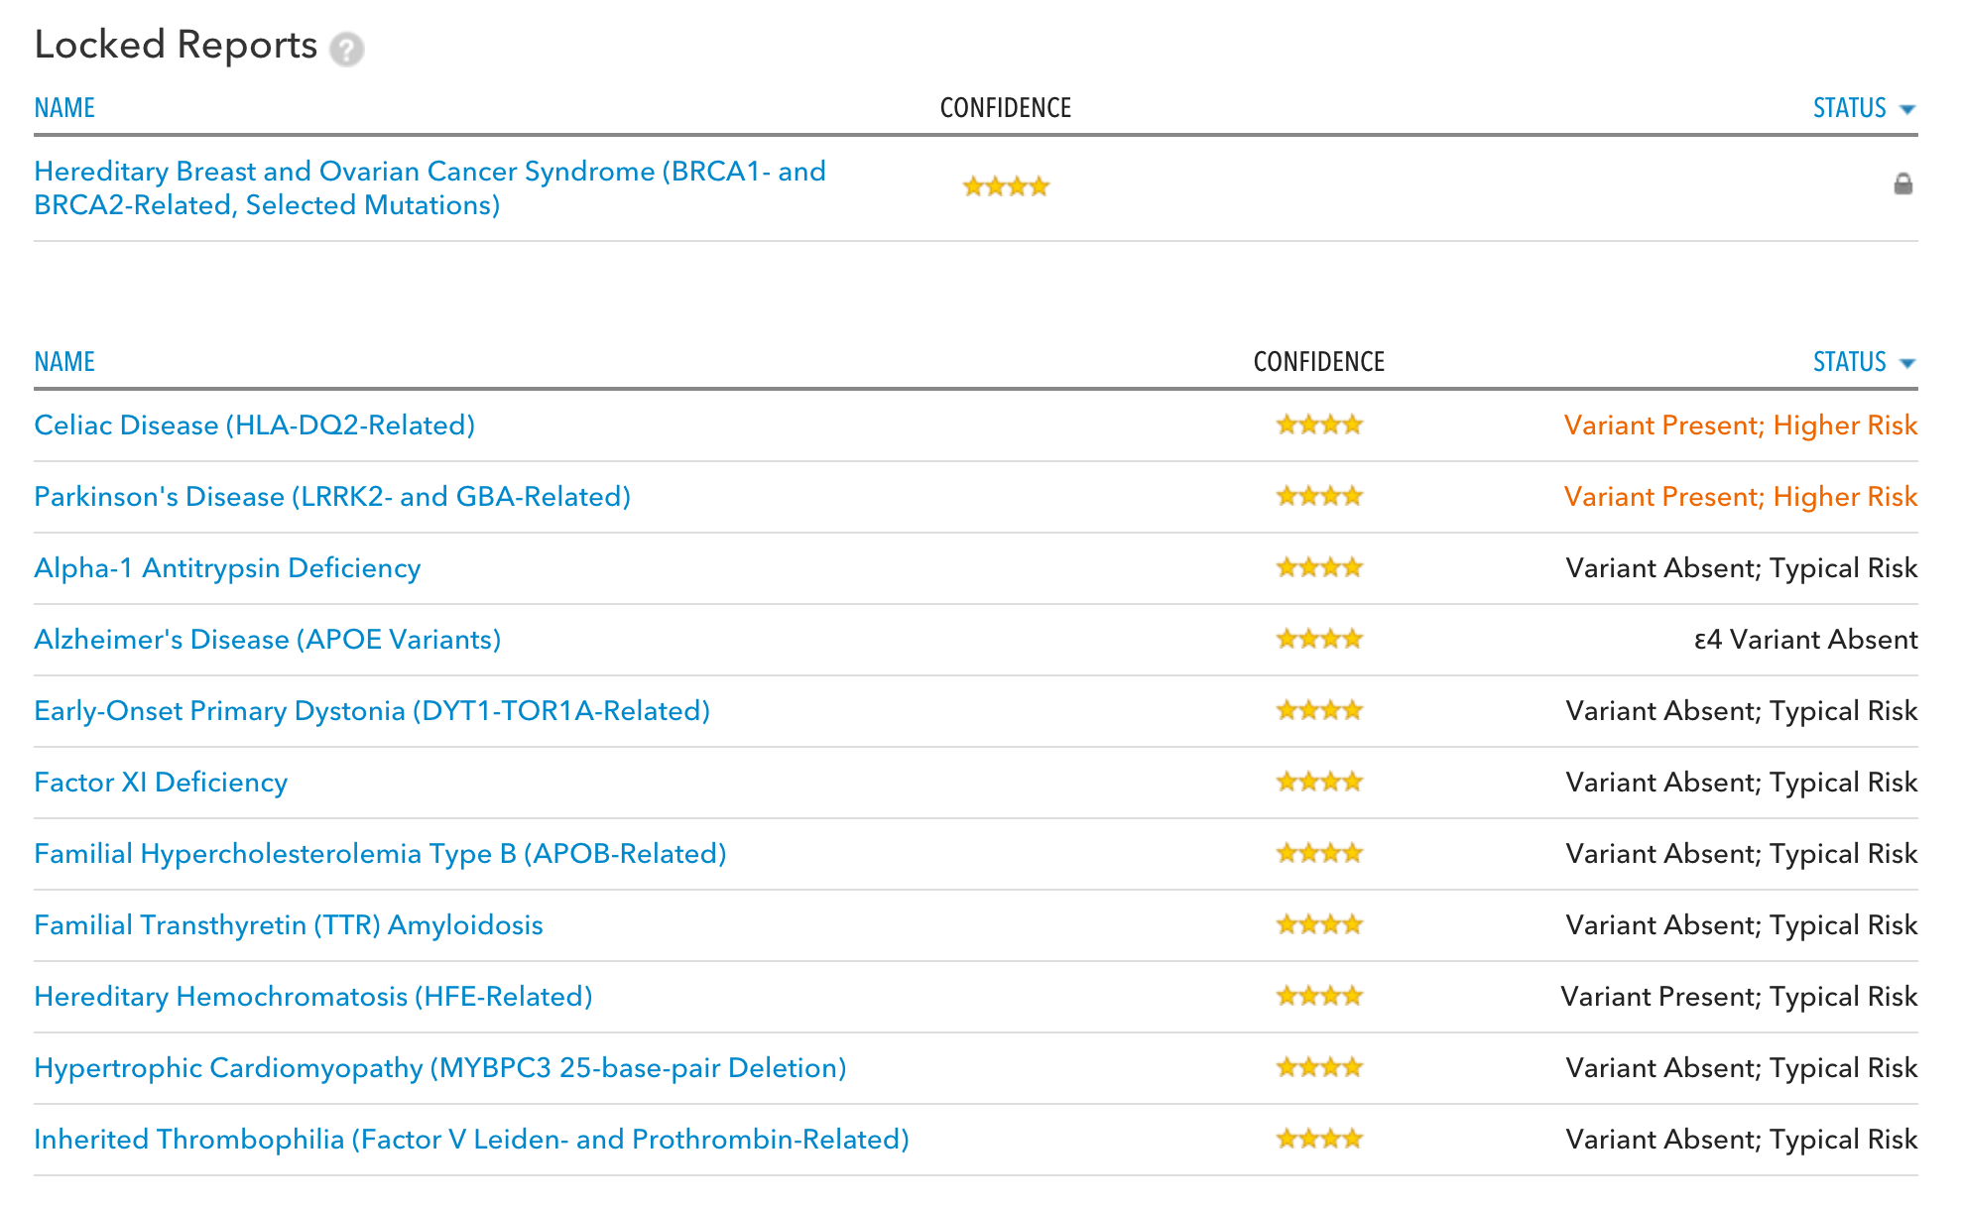

Slide 15
23andme research

Slide 16
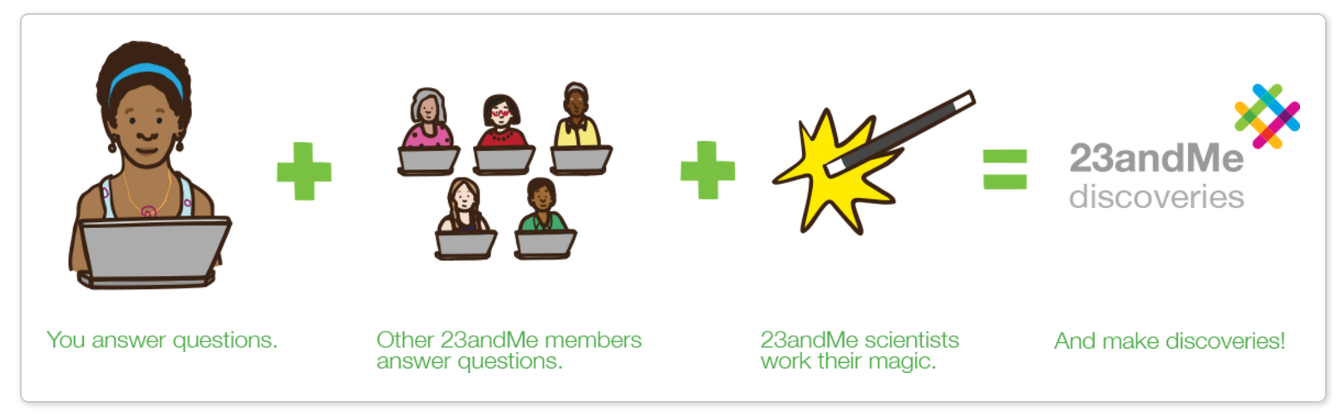
23andme conducts survey-based studies

Slide 17
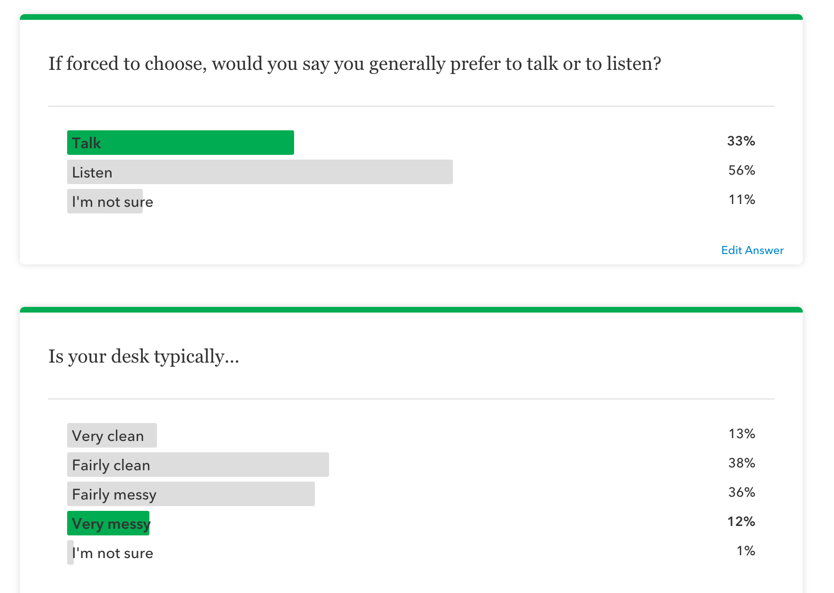

Slide 18
Sociocultural study
https://www.23andme.com/you/23andwe/discoveries/pca_sociocultural/

Slide 19
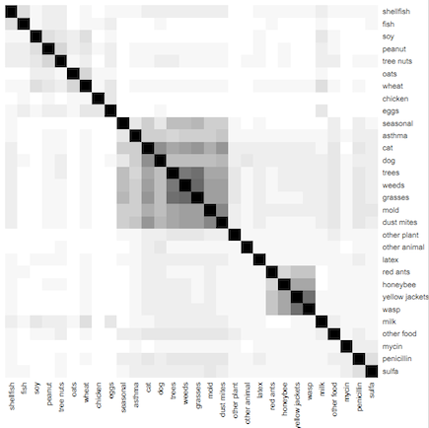
Allergies
https://www.23andme.com/you/23andwe/discoveries/allergy_correlations/

